Slide 1
Bike Turn Indicator with Side Stand Sensor
Prepared By:
Parva Chandarana (EC 51), Sem. V
Ritvik Tiwari (EC 72), Sem. V
Guided By:
Prof. Smith S. Thavalapill
Prof. Hetal B. Shah

Slide 2
Project analysis slide 2
Outline
Conclusion
Abstract
PROJECT
Applications
Block Diagram & Designing
Limitations
Working

Slide 3
Abstract
Inspiration behind undertaking the project
  Thousands of people witness accidents on a daily basis.
  Distracted driving and lack of safety check major reasons
  Aim – To sense a turn and indicate automatically
  A timely indication can avoid a fatal accident
  Additional safety measure – Side stand sensor

Slide 4
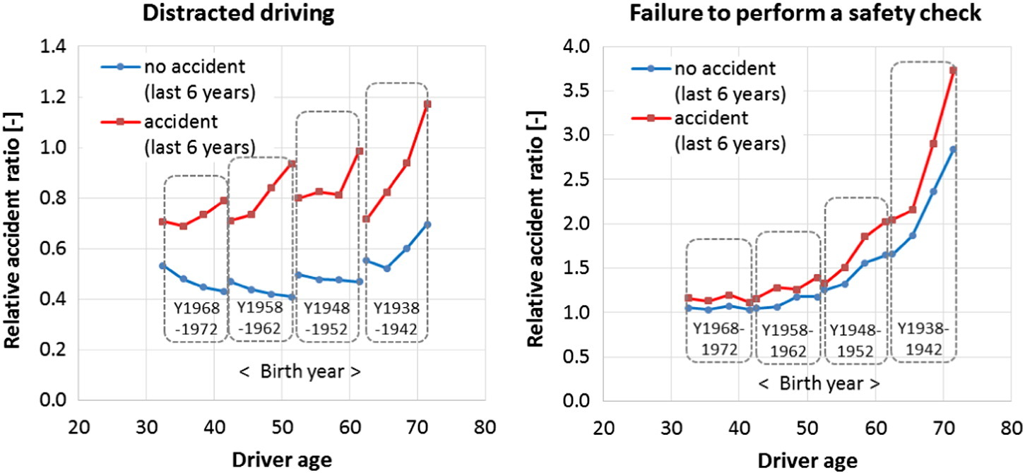
Project analysis slide 5
Abstract
CAR CRASHES
DEATHS
Insurance Claims
1214
821
80,00,000
India witnesses 1214 car crashes daily
More than 800 people loose their lives daily due to road accidents
Number of insurance claims filed for accident related reasons per year
Source - Analyzing accidents and developing elderly driver-targeted measures based on accident and violation records

Slide 5
Project analysis slide 4
Block Diagram
Automatic Bike Turn Indicator.
Implementation Plan
Timing
Circuit
Switching
Circuit
Output Indicator
Sensor
Comparator
Side Stand Sensor
Implementation Plan
Comparator
Output Indicator
Sensor
Transmitter
Receiver

Slide 6
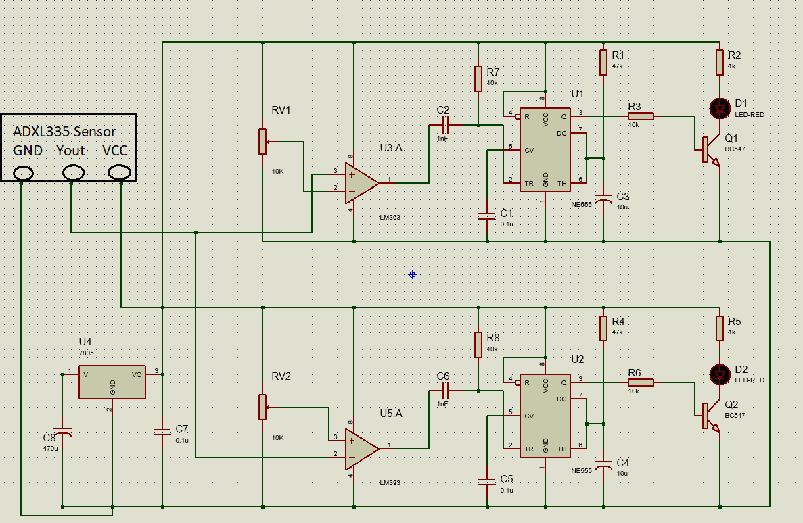
Circuit Diagram
Automatic Bike Turn Indicator

Slide 7
Designing
The primary objective of the system is to sense a turn and indicate it accordingly.
To detect the change in coordinates, an accelerometer sensor is used.
The direction is sensed using a comparator circuit
Monostable multivibrator is used to get desired output. Output duration is 1.1RC = 5.17 secs.

Slide 8
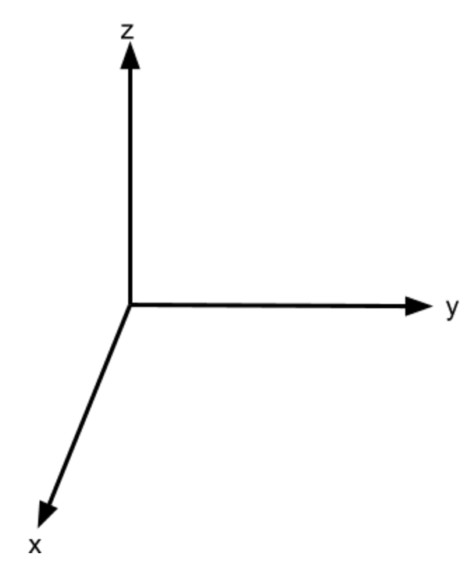
Working of Sensor Circuit
Working
Only Y coordinates are measured in this circuit
Sensor detects the change in coordinates w.r.t change in ‘g’
Voltage at steady position – 1.6V
Right Turn – o/p voltage decreases
Left Turn – o/p voltage increases

Slide 9
Working of Comparator Circuit
Working
Inverting Terminal > Non Inverting Terminal = High
Inverting Terminal < Non Inverting Terminal = Low
Threshold voltage set on basis of accelerometer sensor
Right turn -> Voltage dec.
  Sensor out +ve Terminal
  Threshold -ve Terminal
Left Turn -> Voltage inc.
  Sensor out -ve Terminal
  Threshold +ve Terminal

Slide 10
Working of Timing Circuit
Working
Monostable multivibrator requires trigger i/p
When bike handle is turned and comes back to original position, a trigger pulse is generated
This is caused by the effect of turn on comparator output
Once triggered, 555 IC generates a pulse width delay of 5.17 seconds

Slide 11
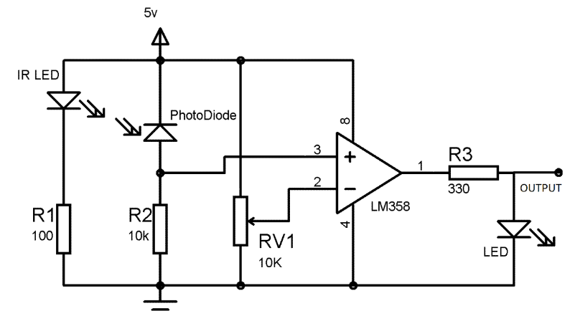
Circuit Diagram
Side Stand Sensor

Slide 12
Designing
For stand sensor, we wish to indicate when the stand is not lifted
IR sensor is used to detect distance b/w ground and stand
Side stand down -> Negligible distance
Side stand lifted -> Considerable distance

Slide 13
Working of Side Stand Circuit
Working
IR Sensor shows o/p when Tx signals are reflected back
Side stand down -> Negligible distance -> Tx signal reflected
Side stand lifted -> Considerable distance -> Tx signal flows
Comparator compares threshold and o/p voltage of IR sensor
Sensitivity varied by varying threshold(by potentiometer)

Slide 14
Project analysis slide 8
Limitations
Sensitivity of sensor.
Circuit is turned on only after handle is moved.
Impossible to analyse data using hardware only, development boards required.
Side stand detector works best during daytime.

Slide 15
Applications
Safety measure for absent minded drivers
A functionality found in luxury cars only, now available to everyone
Much cheaper as compared to the ones present in market
Automatically turns off indicator after turn
Indicates if side stand is not raised
Also useful while changing lanes

Slide 16
Conclusion
This circuit can be used for automatic turn indication and it can be considered as a useful safety feature.
Side stand detector will alarm the driver when stand is open but this feature will be fruitful during day time.
Turn indicator will remain in ON state once triggered for approximately 5.17 seconds.

Slide 17
Thank You

